Slide 1


Azure AD Domain Services Domain Controllers in the Cloud?
Sam Cogan
Solution Architect, Willis Towers Watson & Microsoft MVP

Slide 2





About Me
Sam Cogan
Solution Architect – Willis Towers Watson
Microsoft Azure MVP
samcogan.com
@samcogan
samcogan

Slide 3


In The Beginning!

Slide 4

How do I join machines to this domain?
Where has DNS gone?
I can still do LDAP queries right?
Where do I setup Group Policy?
My application needs LDAP

Slide 5

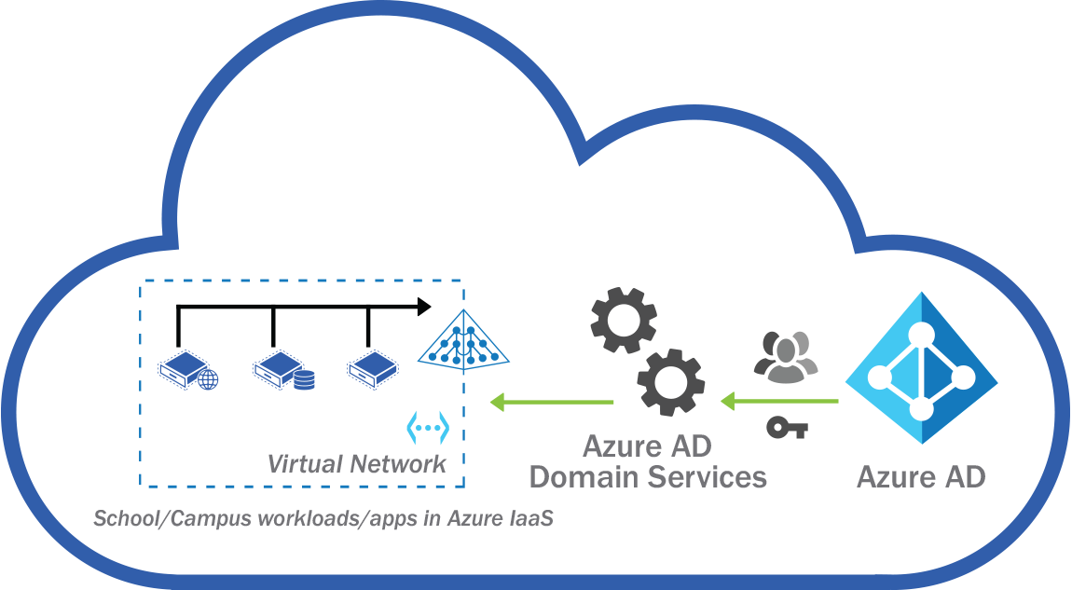

Slide 6

Your scientists were so preoccupied with whether or not they could, that they didn’t stop to think if they should.
Dr Ian Malcolm – Jurassic Park

Slide 7
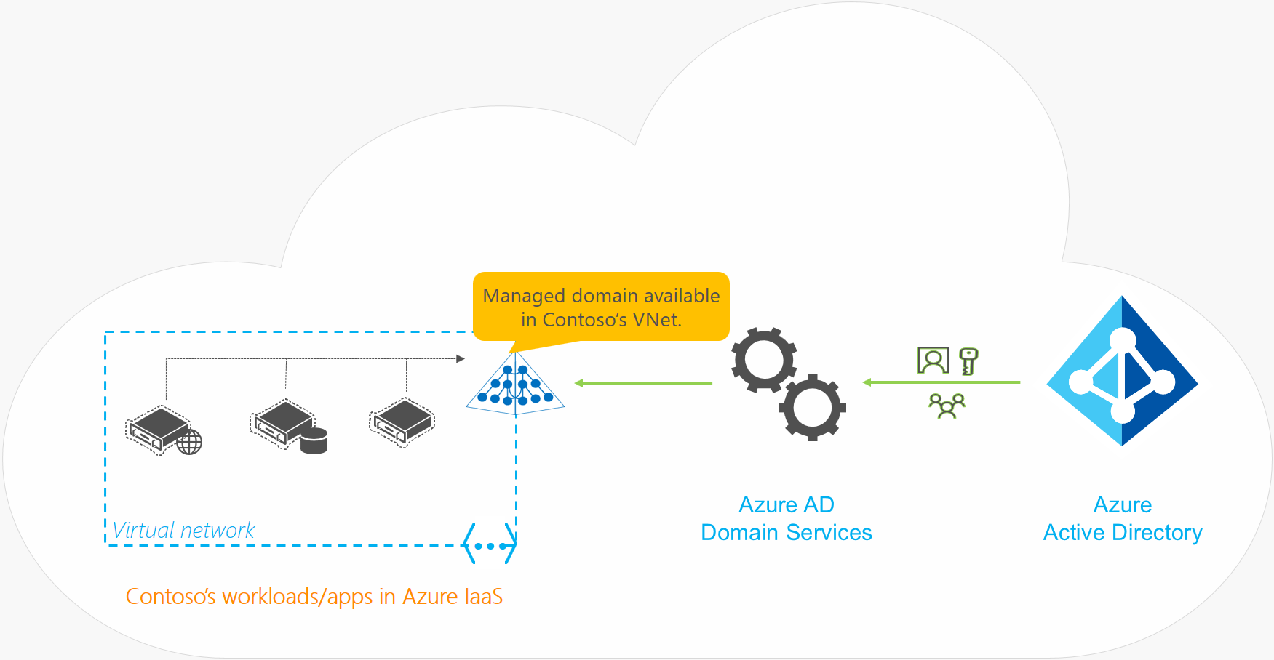
Deployment Scenarios

Slide 8
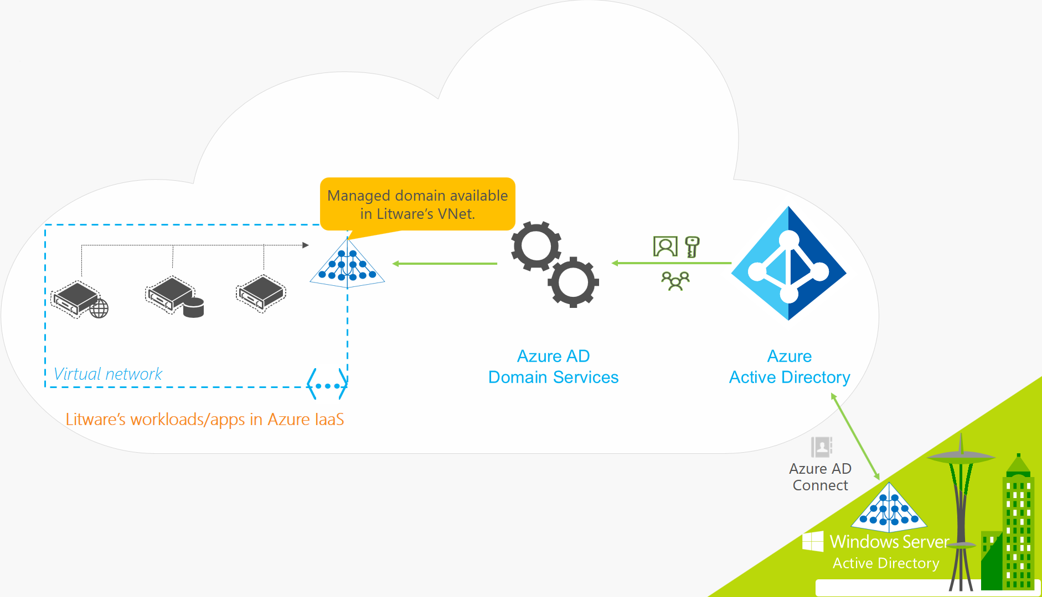
Deployment Scenarios

Slide 9
AAD DS Demo

Slide 10




Benefits
Simple deployment
No management overhead
High availability built in
GPO support

Slide 11




Benefits
Achieve AAD to AD Sync
JIT admin support
No VPN or Express Route
LDAP, NTLM, Kerberos

Slide 12



Resolved Issues
Classic vNet Only
No Custom Ous & GPOS
No ARM Template Support
No support for Kerberos Delegation
Not available in CSP

Slide 13
Current Issues

Slide 14

Multi Region Support

Slide 15

Domain Admin Rights

Slide 16

User Creation

Slide 17

Hybrid Sync

Slide 18

Custom OUs & GPOs

Slide 19

Kerberos Delegation

Slide 20






Other Issues
Limited support for multi-domain forests sync
LDAP support is read only
Password Lifetime and Lockout does not sync
No support for AAD B2C/B2B Users
Limited Regions
Expensive for small workloads

Slide 21
Use Cases

Slide 22

Good Use Cases
Application Lift & Shift
On-Premises User Extension
Azure Files ACLs
Isolated Test Environments
RDS Environments
Simple User Administration

Slide 23

Bad Use Cases
Many production workloads
Replacing your AD Domain
Domain or Schema admin
Unable to support password hash sync
Disaster Recovery

Slide 24


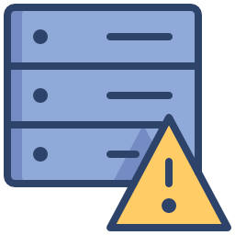
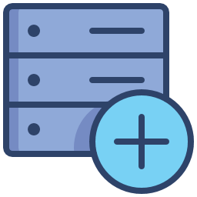
Summary
AAD DS can be a great solution for specific scenarios
AAD DS has limitations and restrictions you need to be able to work within
AAD DS is not a replacement or even a replica of your on premises domain
Deploying domain controllers in Azure is still valid in some scenarios
Lack of Multi-Region support is a big issue

Slide 25
About Me
Sam Cogan
Solution Architect – Willis Towers Watson
Microsoft Azure MVP
samcogan.com
@samcogan
samcogan

